Slide 1
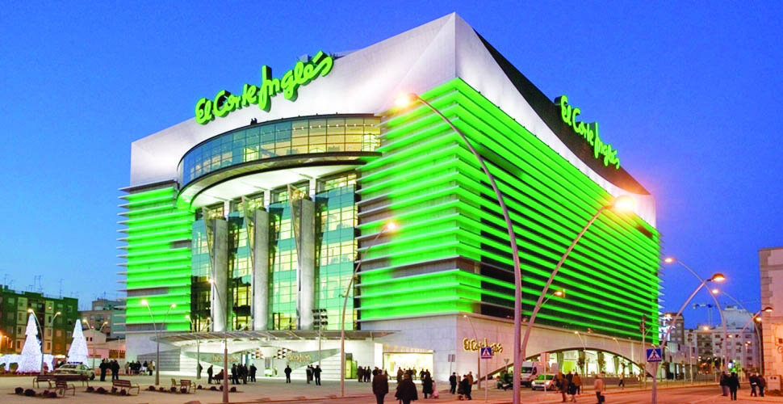
Don Cupón Initiative
Watson Challenge 2019

Slide 2
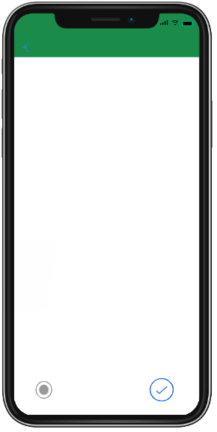

Agenda
Opportunity
Inspiration
The Main Idea
Added Value
Scalability
Technical
Annex
Don Cupón

Slide 3
Opportunities
“28% discounts or annual fees of 9.000€ to 150.000€ for prime shelf space”
- PuroMarketing.com

Slide 4
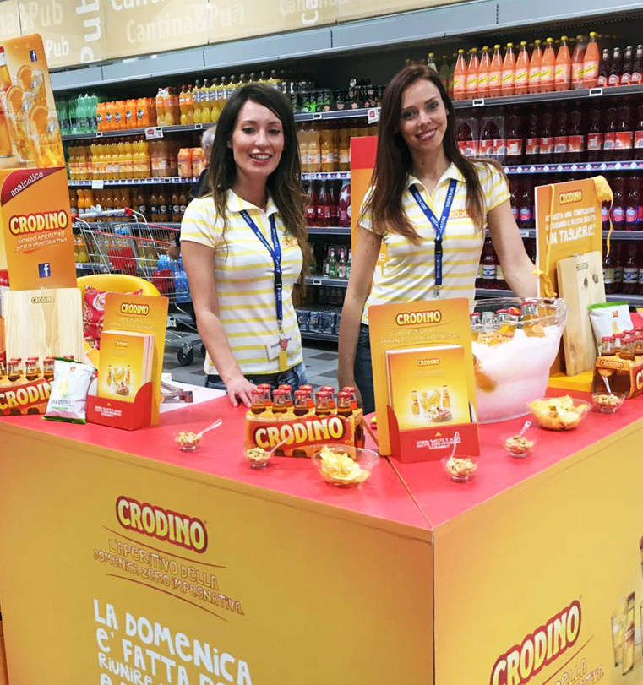
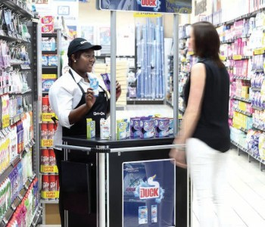
Opportunities
“93% of people that eats free promoted food don’t buy the product”
-Elplazas.com
“7% to 8% of gross revenue in the retail industry is compose of marketing and advertising”
-Smallbusiness.com

Slide 5


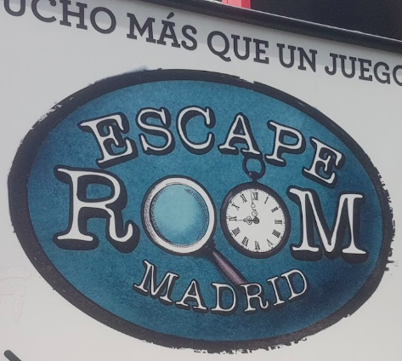
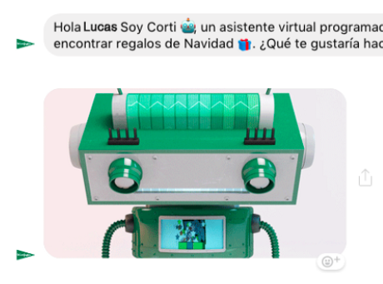

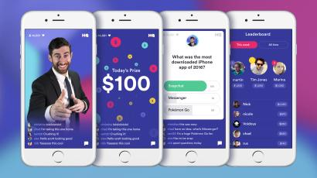
Inspiration
In 2016, people spent more time walking outside playing Pokemon go than using facebook¹
People pay to play games where they find clues and locate objects. Chatbots for escape rooms exist.
1
3
Companies are willing to pay 100.000 USD for doing questions related to their products²
2
4
Corti: El corte ingles christmas chatbot
1 https://sensortower.com/blog/pokemon-go-usage-data

Slide 6

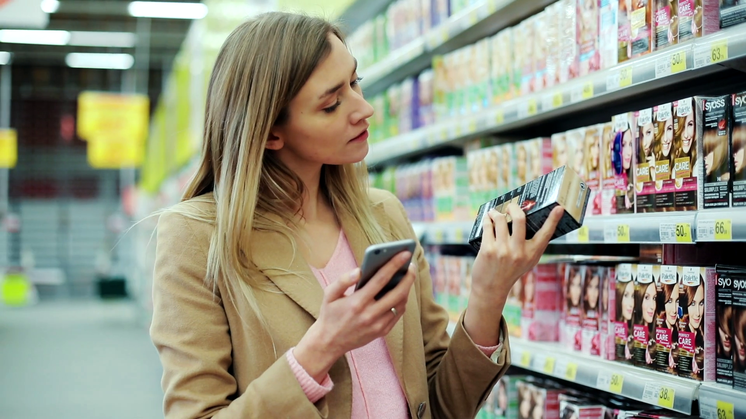

So…what is the idea?
El Corte Ingles
¡

Slide 7



The main Idea…. A game
El Corte Ingles
Free coupons food
help
fun!
Locate/escape room tasks
Helps you find what you need
In just one scan win coupons and get help
Randomly gives facts, hints or talks
Don Cupón
Don Cupón
Trivia questions

Slide 8

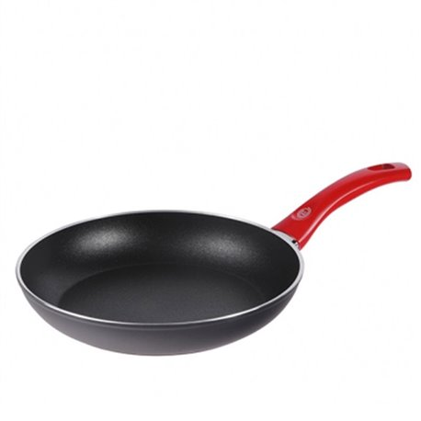
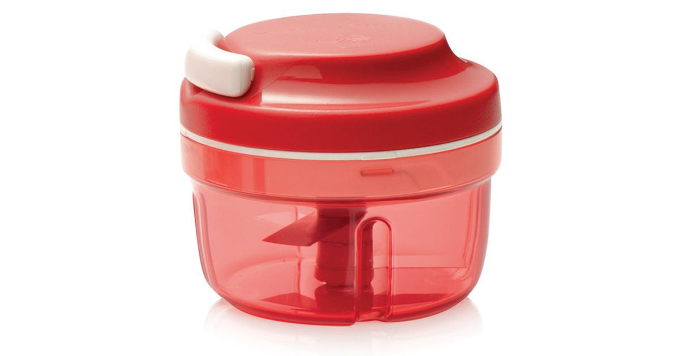
The main Idea…. Prizes
El Corte Ingles
Shopping store
Game Points to exchange in gift shop
Free product paid by companies that are promoting
Pan for Kitchen
250 points
Discounts for products that are in promoting
Benefits like free shipping, more Than 6 item in fast line
tupperware
Don Cupón
Clients with loyalty card will get better awards

Slide 9
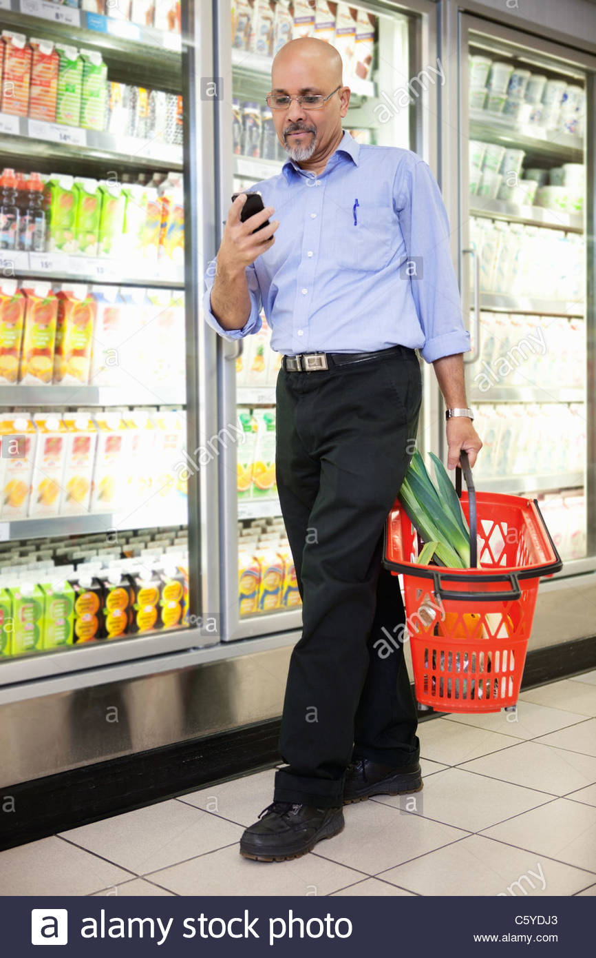
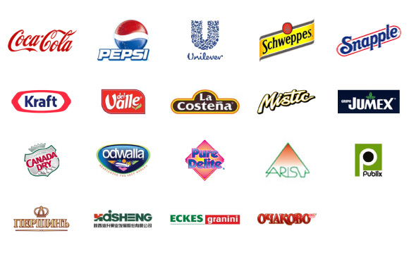
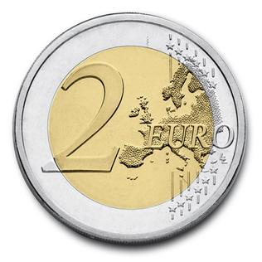


Payment Methods
El Corte Ingles
Food brands & small retailers
User
Don Cupón
Supermarket
Retailers pays 2 euros to supermarket for each publicity aparence
¡

Slide 10
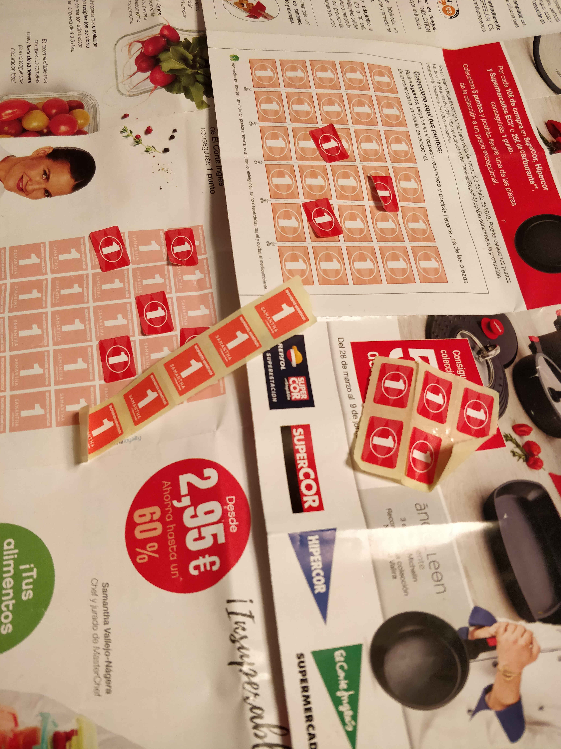
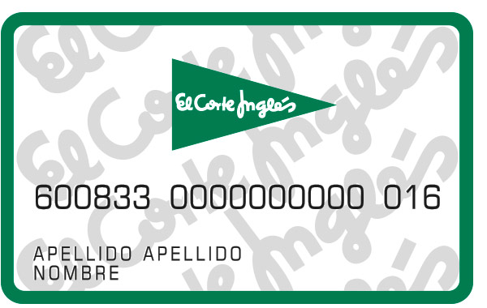
Added Value
El Corte Ingles
Obsolete coupon method
Supermarket: potential revenue stream + cross-sell of products
Super Market employees: Decrease questions asked by customers
Producers: cheaper marketing
Customers: discounts + free food
What is the special ingredient of this beer?....
Increase Loyalty Membership
Chocolate
Great you won 20 points
Don Cupón
¡

Slide 11

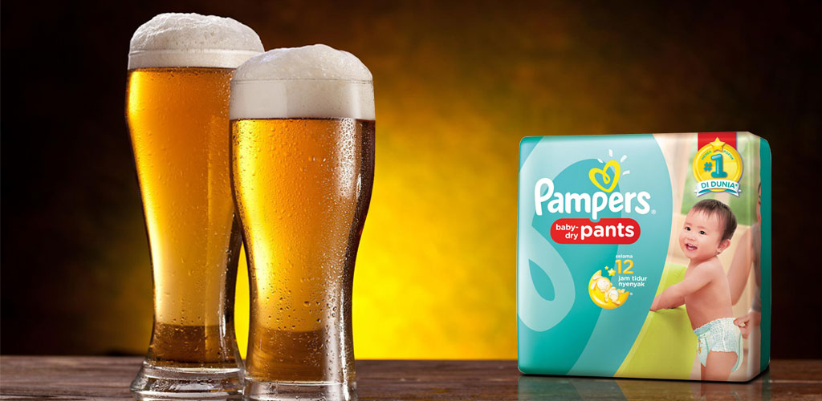
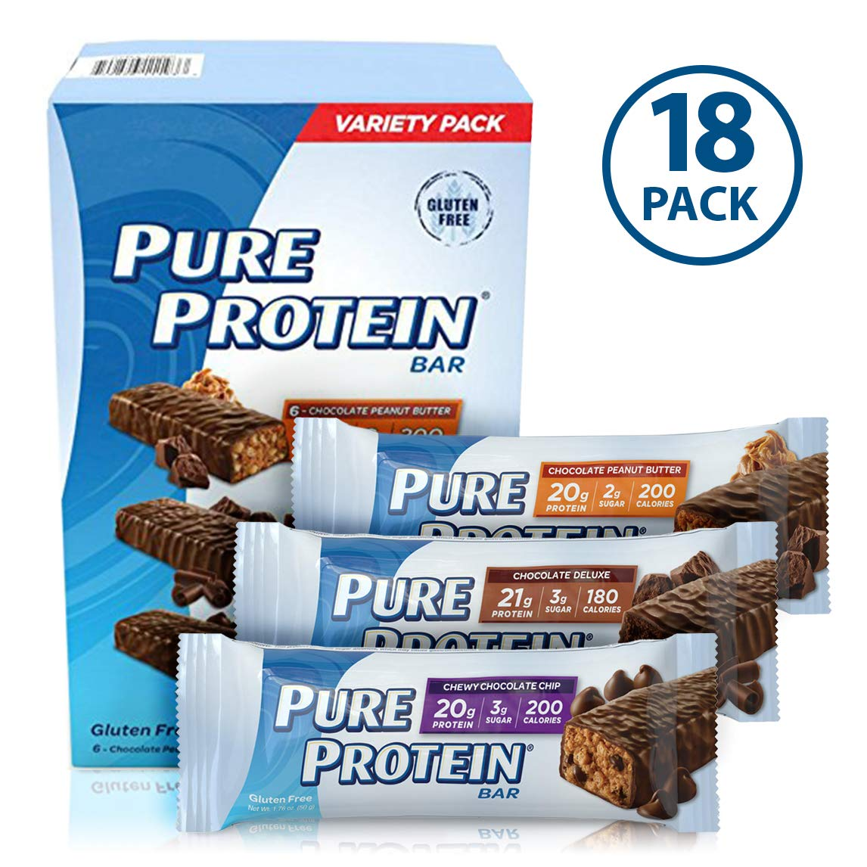
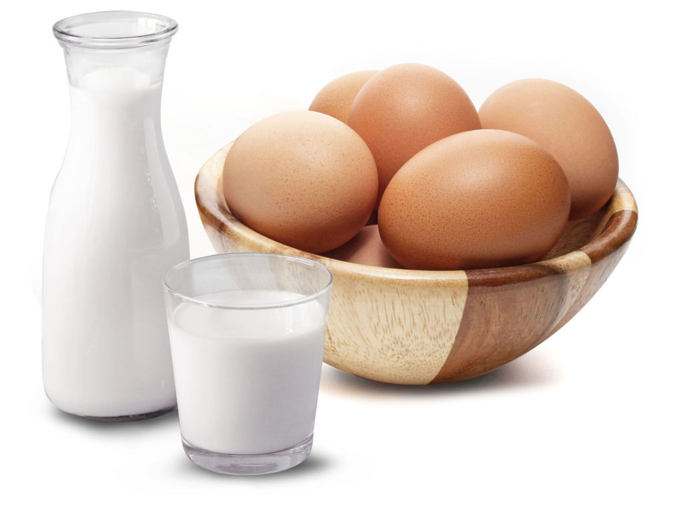
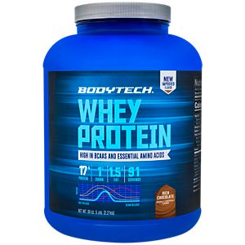
Basket Analysis
El Corte Ingles
Antecedent and Consequent: Association analysis to determine which product come together.
Game questions related to the consequent of the product the client is looking for.
¡

Slide 12




Assumptions
=
Fee per each client playing a publicity games
2 Euros
Google
Avg. cost per click 2€
=
# of games played in one super market each month
850
IBM chatbot fee 0.0025 per API call
=
# of new users subscribing per month in each market
600
=
First price cost
- 2 Euros
=
25K Euros & 400K for maintenance
First Chatbot Incorporation to supermarket cost
Ref: https://fitsmallbusiness.com/google-advertising-cost/
¡

Slide 13
Financial Projections
Number of supermarket using “Don Cupon”
Cost Vs Revenues (THOUSAND EUROS)
Number of clients using “Don Cupon”
Total Gross Income excluding cost
¡

Slide 14


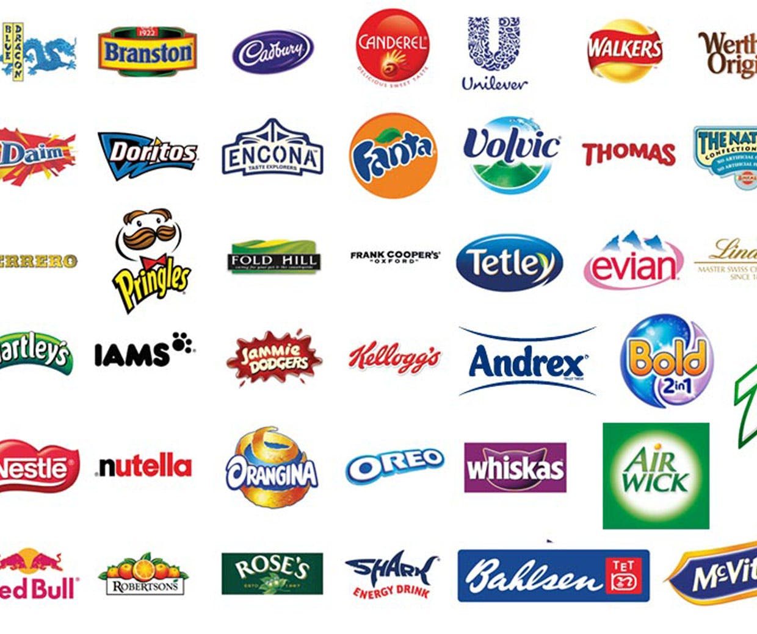

Scalability
90 stores
Pilot
El Corte Ingles
Apply the same structure to al the other 90 stores
Usually all supermarkets share the same structure, brands, and coupons. So scalability is fast.
¡

Slide 15
Financial Model
Revenues Stats for chatbot
Revenues in chatbot |  | M 1 | M2 | Q1 | Q2 | Q3 | Y1 | Y2 | Y3
Publicity questions |  | 1.700 | 8.500 | 20.400 | 86.700 | 198.900 | 357.000 | 1.387.200 | 2.080.800
Antecedent |  | 500 | 2.500 | 6.000 | 25.500 | 58.500 | 105.000 | 204.000 | 204.000
Loyalty Referal |  | 120 | 600 | 1.440 | 6.120 | 14.040 | 25.200 | 48.960 | 48.960
Total Income generated by chatbot |  | 2.320 | 11.600 | 27.840 | 118.320 | 271.440 | 487.200 | 1.640.160 | 2.333.760
Cost and expenses related to chatbot
Chatbot Incorporation to super market |  | -35.000 | -59.000 | -77.000 | -131.000 | -185.000 | -239.000 | 0 | 0
Mantainence cost |  | -1.200 | -2.400 | -3.600 | -7.200 | -10.800 | -14.400 | -400.000 | -400.000
First gift |  | -1.200 | -6.000 | -14.400 | -61.200 | -140.400 | -252.000 | -147.000 | -147.000
Net Income for chatbot |  | -35.080 | -55.800 | -67.160 | -81.080 | -64.760 | -18.200 | 1.093.160 | 1.786.760
Inertia Effect
Number of clients using chatbots |  | 600 | 3.000 | 7.200 | 30.600 | 70.200 | 126.000 | 370.800 | 615.600
Number of clients buying new product shown by chatbot |  | 210 | 1.050 | 2.520 | 10.710 | 24.570 | 44.100 | 129.780 | 215.460
Supermarket margin in new product sold |  | 630 | 3.150 | 7.560 | 32.130 | 73.710 | 132.300 | 389.340 | 646.380
Total revenew after inertia |  | -34.450 | -52.650 | -59.600 | -48.950 | 8.950 | 114.100 | 1.482.500 | 2.433.140
# of supermarkets using chatbot = |  | 1 | 4 | 7 | 16 | 25 | 34 | 34 | 34

Slide 16
Don Cupón: Bye, nice to meet you!
Watson Challenge 2019

